Slide 1




NEXT GEN EMPLOYABILITY PROGRAM
Creating a future-ready workforce
Team Members
College Name
Student Name :Blessy Evangline
Student ID : au960221104046
Arunachala College Of Engineering For Women

Slide 2

CAPSTONE PROJECT SHOWCASE
Project Title
Car Rentals Application with Django Framework
Abstract | Problem Statement | Project Overview | Proposed Solution | Technology Used | Modelling & Results | Conclusion

Slide 3
Abstract:
It is a system design especially for large, premium and small car rental business. The car rental system provides complete functionality of listing and booking car . In this system, Tourism and Travelling facilities also provide . This application can be used by car rental businesses to manage their fleet and facilitate online bookings . This abstract provides a high-level overview of the car rental application built with Django.
Source :

Slide 4
Problem Statement:
This application should allow users to browse available cars, make reservations, view rental history, and manage their profiles . Additionally, the system should support administrative functionalities such as adding new cars, managing rental requests, and generating reports . The goal is to create a user-friendly and efficient platform for both customers and administrators to manage car rentals effectively.
Source :

Slide 5
Project Overview:
Develop a comprehensive web-based platform using Django framework for managing car rentals efficiently. The application aims to provide users with a seamless experience for browsing, reserving, and managing rental vehicles, while also offering administrators the tools to manage inventory, rental requests, and generate reports . Implement secure user authentication and registration functionality for customers and administrators.
Source :

Slide 6
Proposed Solution:
.
Project Setup: Create a new Django project and app for the car rental system .
Define Models: Develop the models mentioned above using Django's ORM (Object Relational Mapper).
Build Views: Implement views for handling user interactions like car search, booking, and account management .
Templates: Create HTML templates for displaying the application's user interface .
Admin Panel: Set up the admin interface to manage car information, rentals, and user accounts .
Deployment: Deploy your application to a web server to make it publicly accessible.
Source :

Slide 7
Creating a Next Gen Employability program for a car rentals application involves several components:
Skill Development: Identify key skills required for roles within the company, such as customer service, sales, vehicle maintenance, and administration.
Training Modules: Develop training modules focusing on these skills, including both theoretical knowledge and practical application.
Technology Integration: Incorporate training on using the car rentals application effectively, including booking management, vehicle tracking, and customer communication features.
Soft Skills: Include training on soft skills like communication, problem-solving, teamwork, and adaptability, essential for success in any role.
Source :

Slide 8
Mentorship Program: Pair new hires with experienced employees to provide guidance and support throughout their training period.
Assessment and Feedback: Implement regular assessments to track progress and provide constructive feedback to employees, helping them improve continuously.
Career Path Development: Offer opportunities for advancement within the company, with clear pathways and development plans for employees to progress in their careers.
Continuous Learning: Encourage a culture of continuous learning and skill development through ongoing training sessions, workshops, and access to online resources.
By implementing these components, the Next Gen Employability program can effectively prepare employees for success within the car rentals application, enhancing their employability and contributing to the company's overall success.
Source :

Slide 9


Technology Used
Front-end
Back-end
Source :

Slide 10
Modelling & Results:
The application can improve efficiency by automating car search, booking, and rental management processes . A well-designed interface can attract and retain customers with a user-friendly experience . Online booking reduces manual workload for staff and allows for faster processing of rentals . The admin panel provides centralized control over car information, user accounts, and rental data . A car rental application built with Django can create a user-friendly platform for customers and improve operational efficiency for the business.
Source :

Slide 11
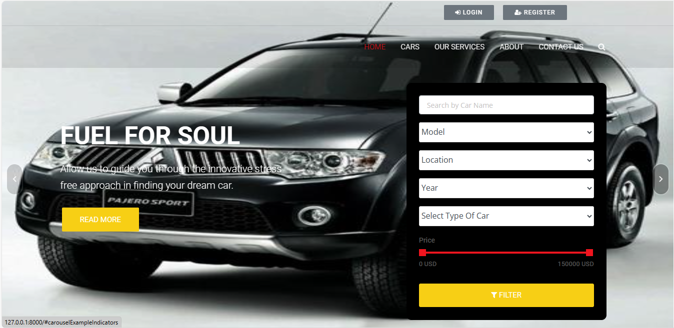
Homepage

Slide 12
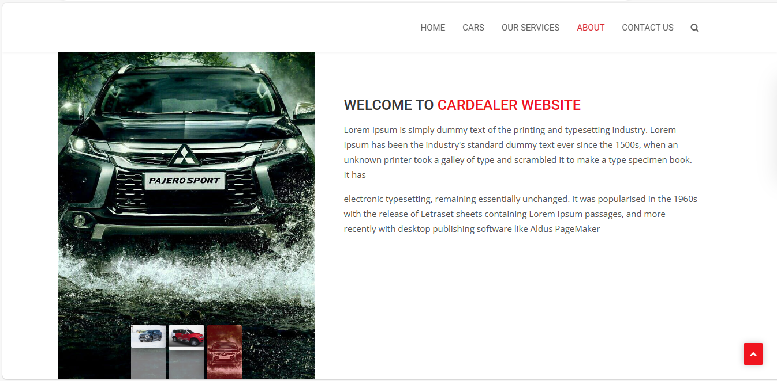
About-Us-Page

Slide 13
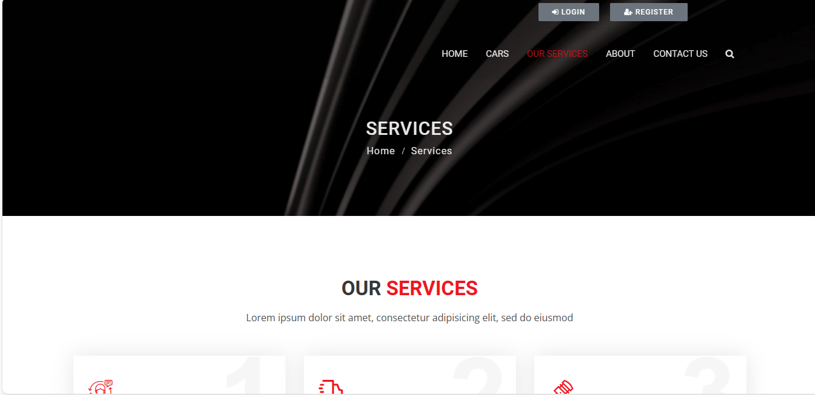
Service-Page

Slide 14
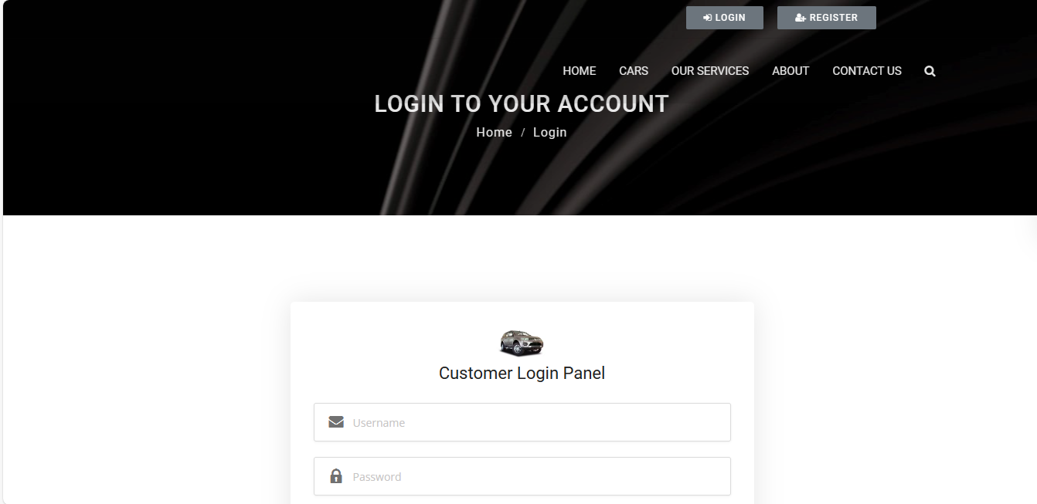
Login Page

Slide 15
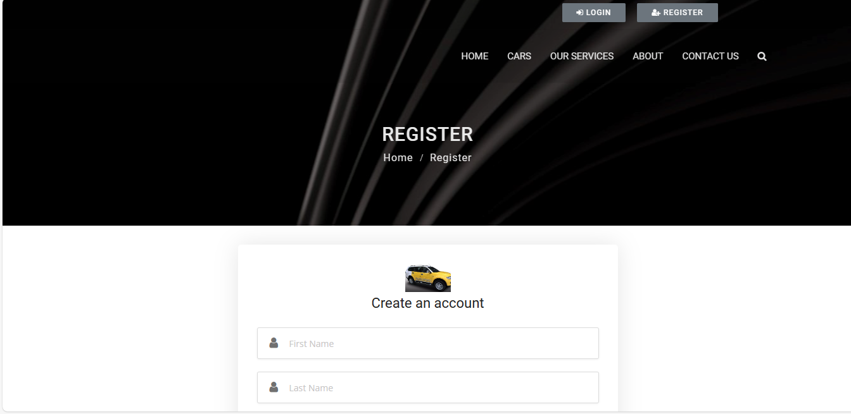
Register Page

Slide 16
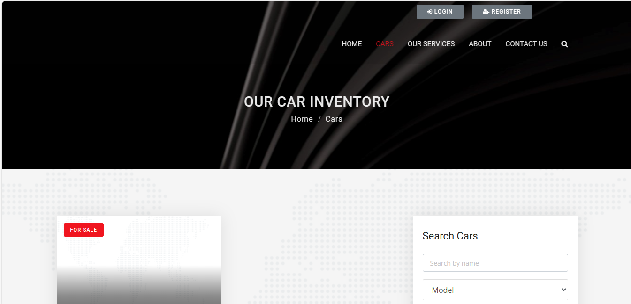
Our Car Inventory

Slide 17
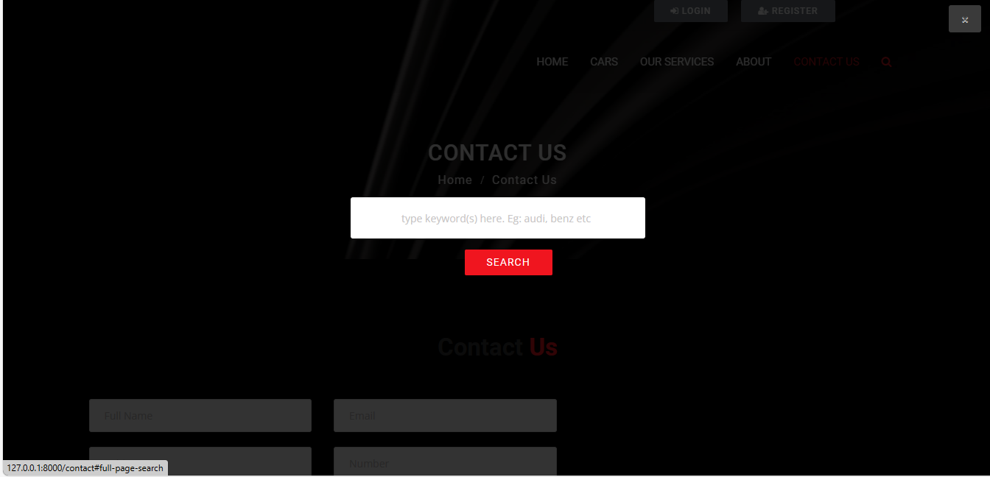
Search Page

Slide 18
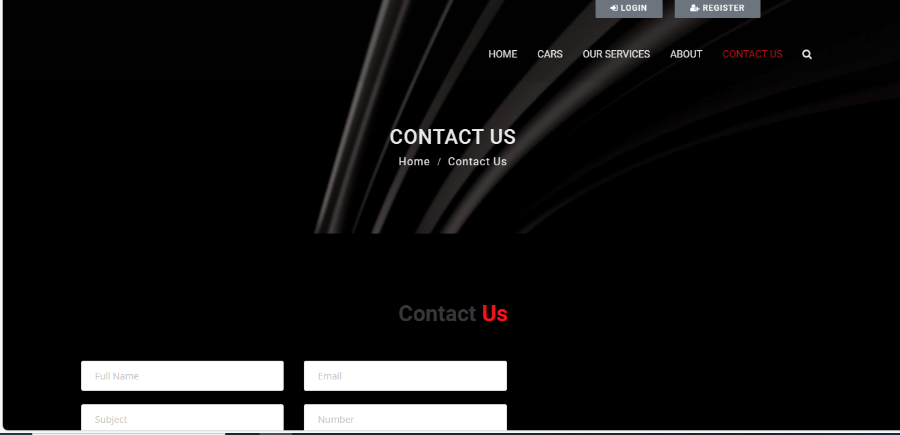
Contact Page

Slide 19
Future Enhancements:
Payment gateway integration: Integrate with popular payment gateways like Stripe or PayPal for secure online payments . Automatic insurance options: Offer users the option to purchase rental car insurance during the booking process, potentially integrating with insurance providers . Paperless rentals: Implement a system for digital contracts and electronic signatures .Integrate with telematics systems to track car location, fuel levels, and potential maintenance needs.

Slide 20
Conclusion:
Users can conveniently search for available cars based on various criteria, simplifying the car selection process . A clear calendar view helps users visualize car availability for their desired rental period . The admin panel provides centralized control over car information, user accounts, and rental data . We can create a comprehensive car rental application that delivers a positive experience for both users and the business.
Source :

Slide 21
Thank You!
Notes:
Thank You !!

